Slide 1

Diamonds Collection Online shop (ONLINE SHOPPING) Java Full Stack Developer By Sutar Ankita (EBEONO62139204) Under the guidance of Shalini Kumari (Technical Trainer)
Edu Bridge Learning

Slide 2
CONTENTS
Introduction
Software & Hardware details
View of Web Page
Advantages
Future Scope
Conclusion

Slide 3
Introduction
Diamonds Collection Online shop Project has been developed on Java Spring Boot and MySql. Diamonds Collection Online shop is an application which is based on managing the Jewellery items and sell the Jewellery items Online. This application is very simple and impressive.
The main objective behind this application Diamonds Collection Online shop is to provide all the details about Jewellery items. There is a single role user i.e., admin in this project who can manage all the activity. Admin can manage Jewellery items, he can add products, delete the Products, Edit the products.

Slide 4
Software & Hardware details
Software Requirements
Platform : Spring Boot, Thymeleaf , html, css ,MySql.
IDE : Eclipse, MySql WorkBench
Editor : Windows 10
Hardware Requirements
Intel Core
8 GB Ram
Minimum Requirements
Intel Core/AMD
256MB RAM

Slide 5
Spring Boot
Spring Boot provides a good platform for Java developers to develop a stand-alone and production-grade spring application that you can just run. You can get started with minimum configurations without the need for an entire Spring configuration setup.
Advantages:
Spring Boot offers the following advantages to its developers −
Easy to understand and develop spring applications
Increases productivity
Reduces the development time

Slide 6
Technologies:
Goals
To avoid complex XML configuration in Spring
To develop a production ready Spring applications in an easier way
To reduce the development time and run the application independently
Offer an easier way of getting started with the application
Why Spring Boot?
It provides a flexible way to configure Java Beans, XML configurations, and Database Transactions.
In Spring Boot, everything is auto configured; no manual configurations are needed.
It offers annotation-based spring application
Eases dependency management

Slide 7
Thymeleaf:
Thymeleaf is a Java library. It is an XML/XHTML/HTML5 template engine able to apply a set of transformations to template files in order to display data and/or text produced by your applications. ... The main goal of Thymeleaf is to provide an elegant and well-formed way of creating templates.
HTML:
HTML stands for Hyper Text Markup Language. HTML is the standard markup language for creating Web pages. HTML describes the structure of a Web page. HTML consists of a series of elements. HTML elements tell the browser how to display the content.

Slide 8
Technologies:
CSS:
Cascading Style Sheets, fondly referred to as CSS, is a simply designed language intended to simplify the process of making web pages presentable. CSS allows you to apply styles to web pages. More importantly, CSS enables you to do this independent of the HTML that makes up each web page.
MYSQL:
MySQL is a relational database management system based on SQL – Structured Query Language. The application is used for a wide range of purposes, including data warehousing, e-commerce, and logging applications.

Slide 9
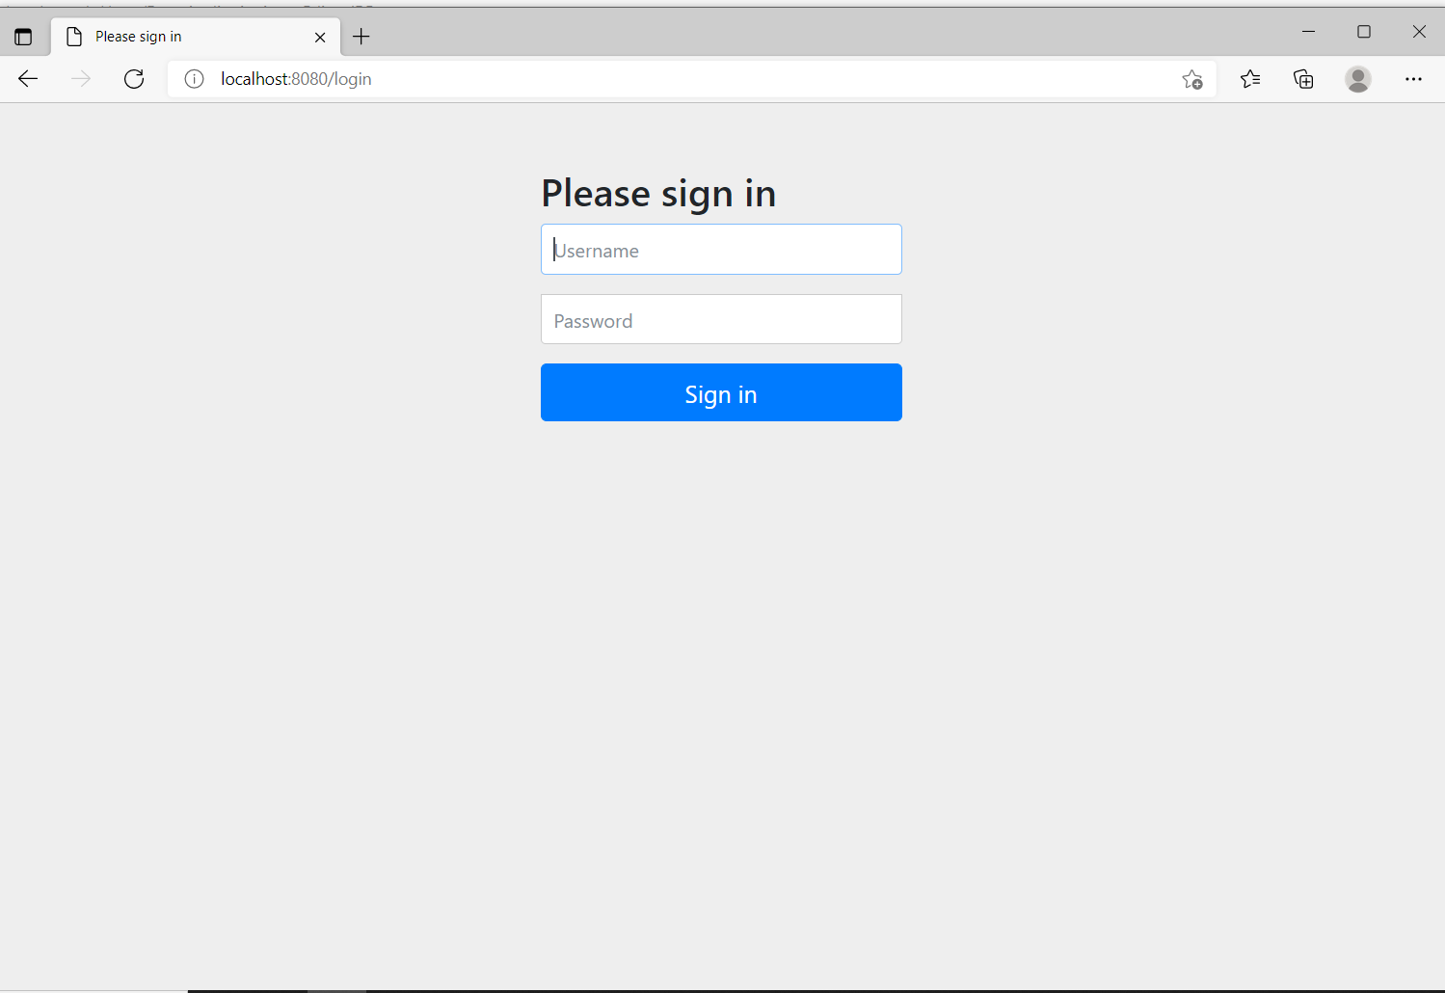
View of Web Page

Slide 10
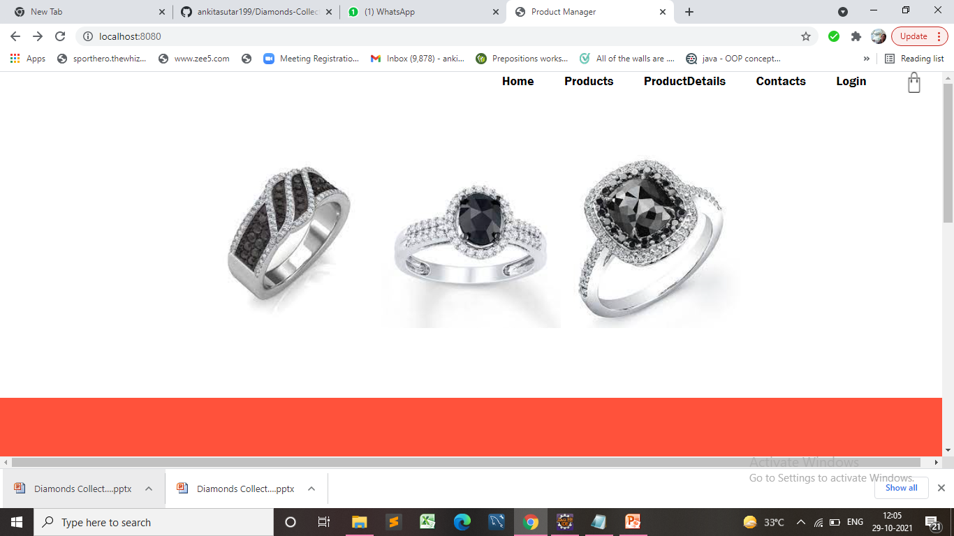

Slide 11
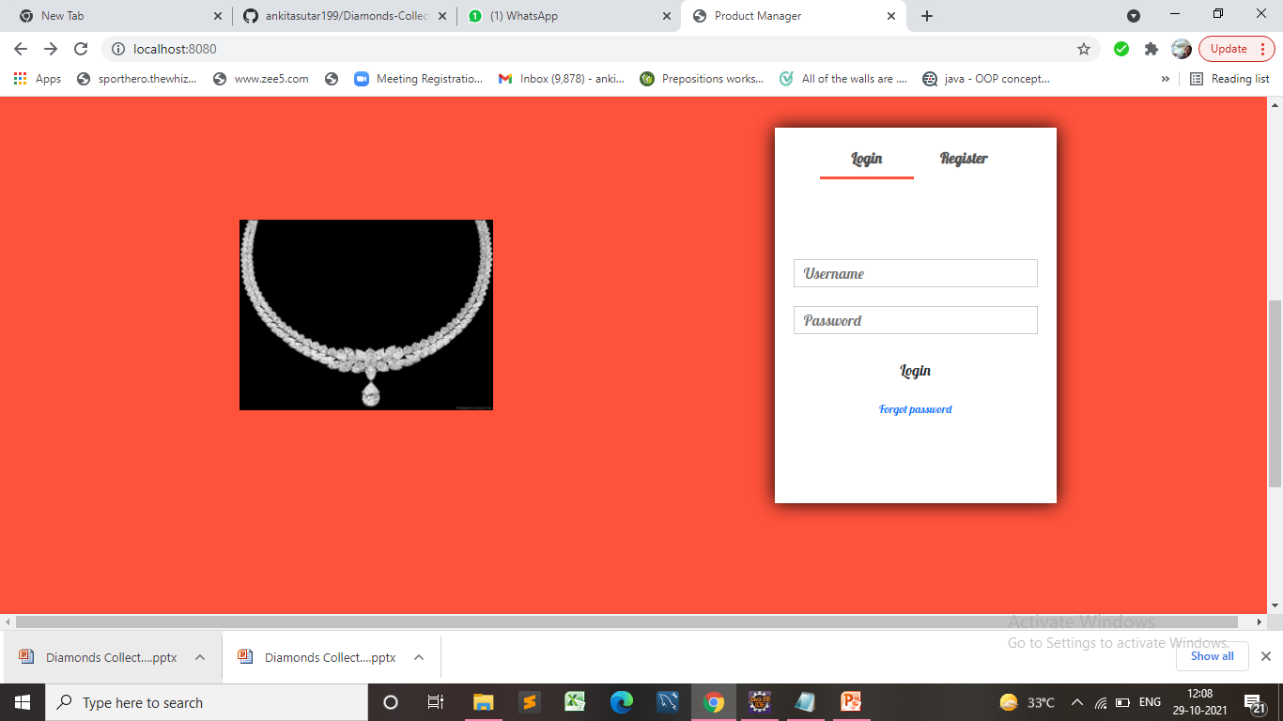

Slide 12
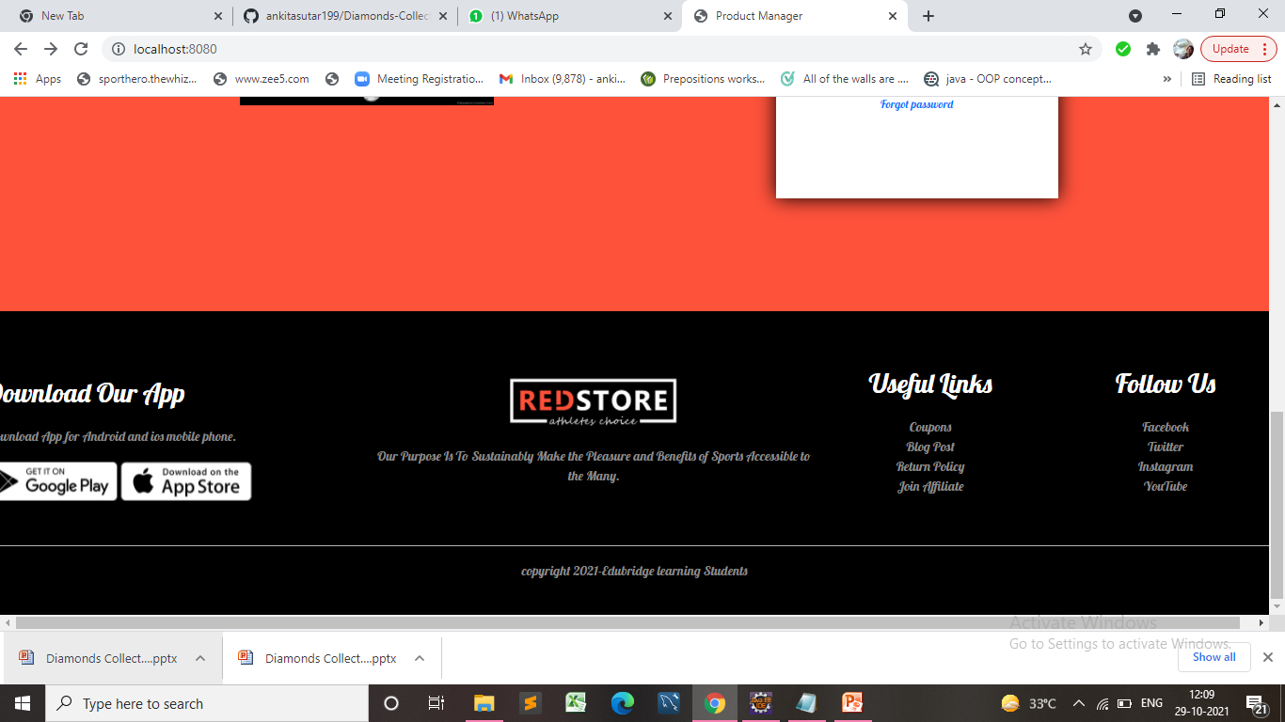

Slide 13
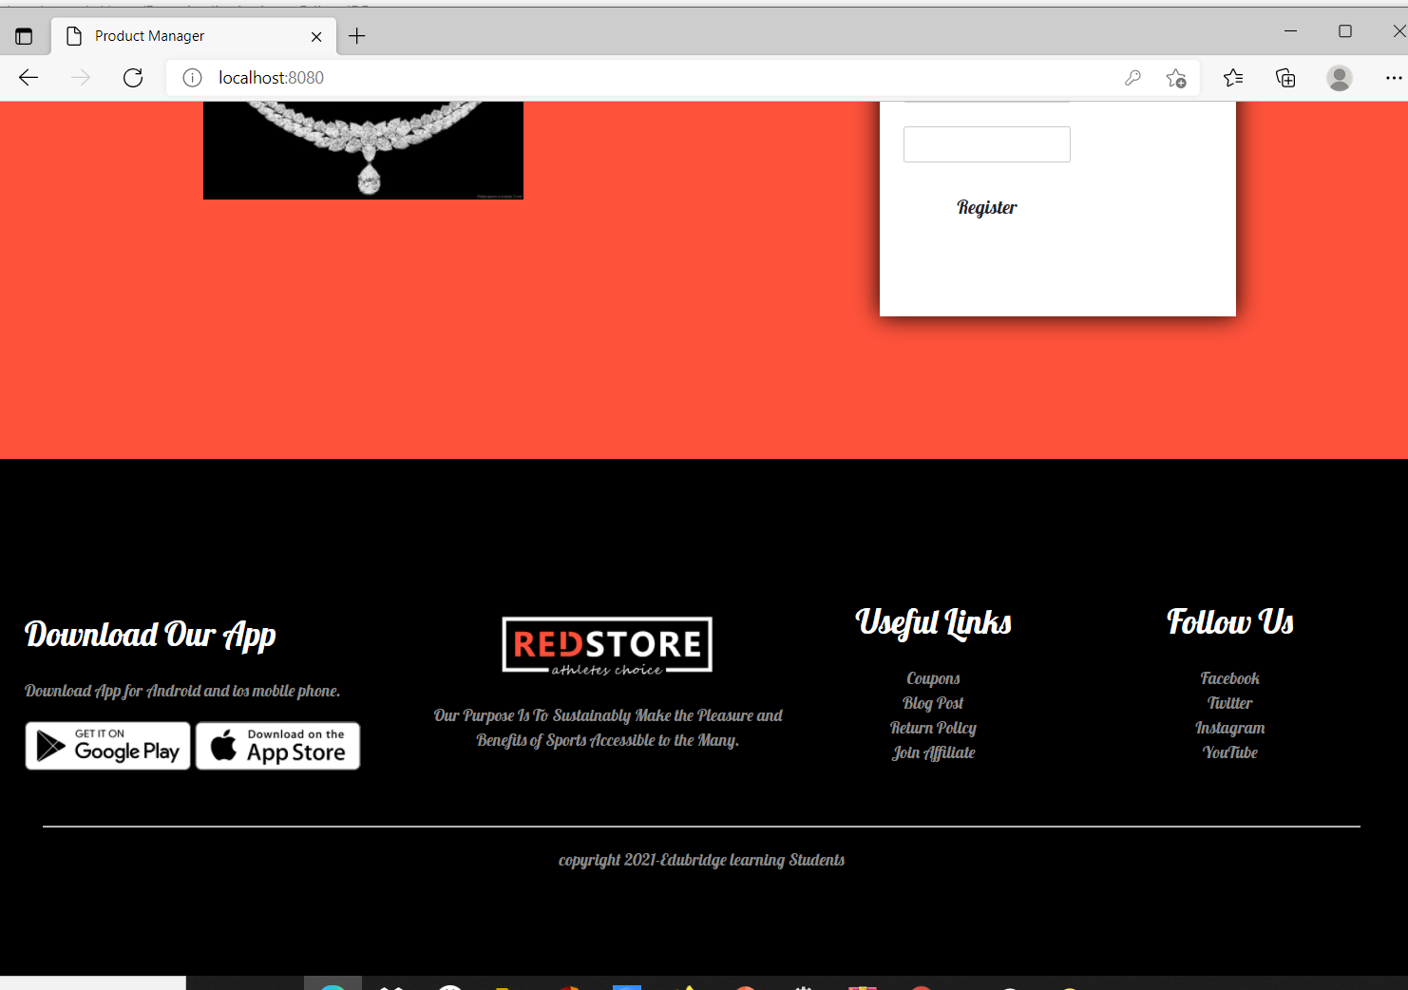

Slide 14
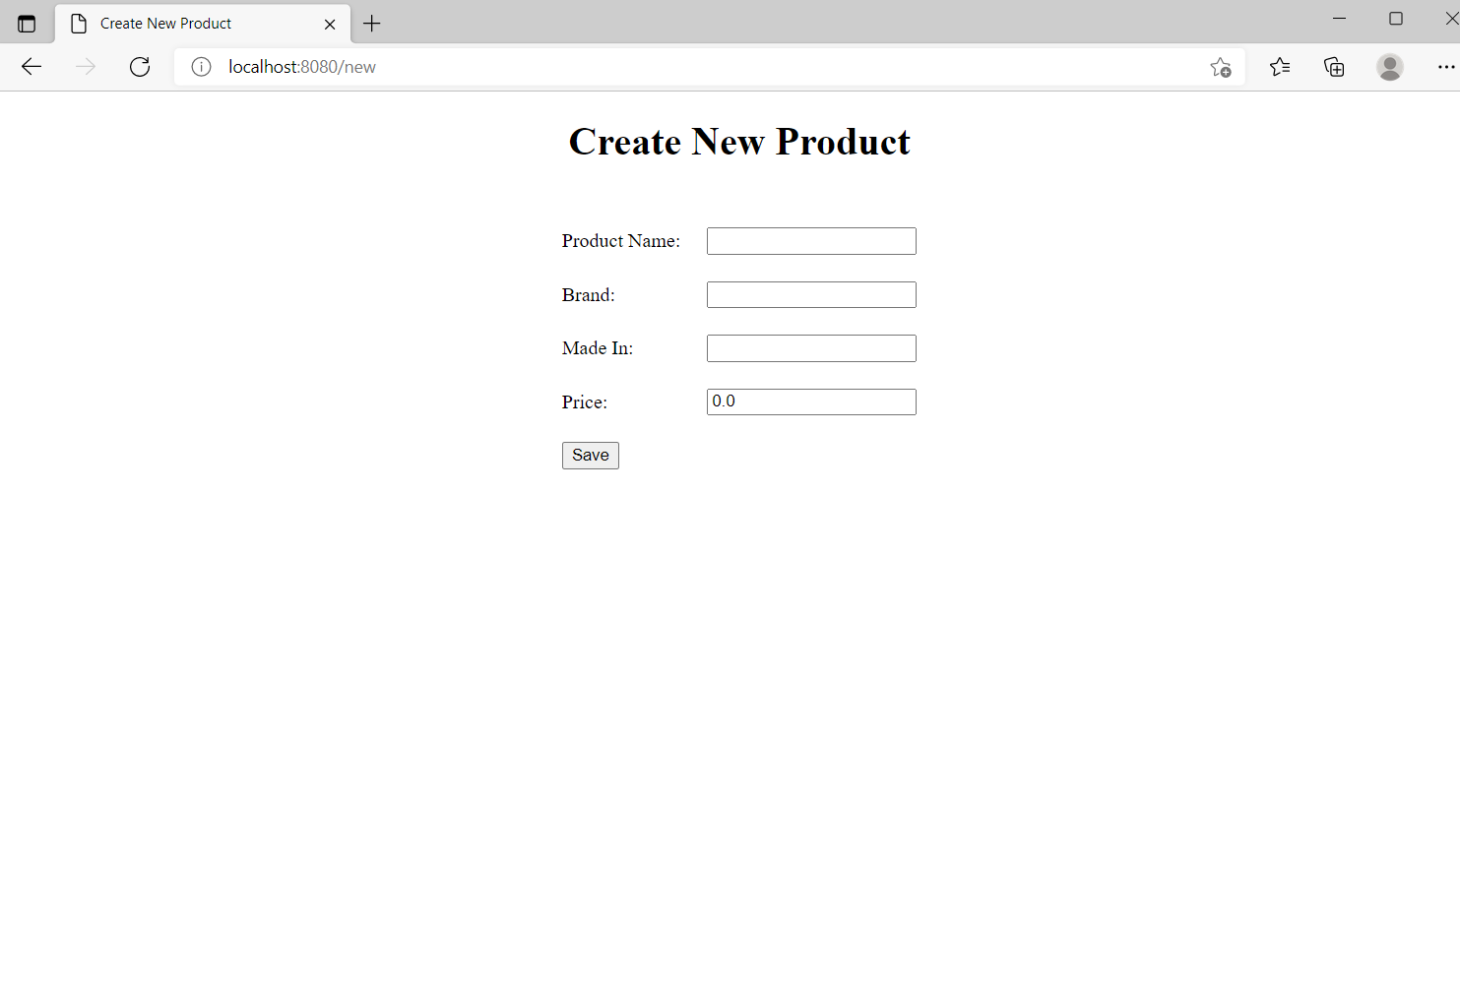

Slide 15
Advantages
Utterly convenient. This is one big reason why more and more people are into online shopping.
A wider selection. Compared to physical stores, online jewelry shops offer a wider range of designs.
Lower prices.
Informative.
Fast.

Slide 16
Future Scope
The scope of the project includes that what all future enhancements can be done in this system to make it more feasible to us:-
Databases for different products range and storage can be provided.
Multilingual support can be provided so that it can be understandable by the person of any language.
More graphics can be added to make it more user-friendly and understandable.
Manage & backup versions of documents online

Slide 17
Conculsion
It is an user friendly application and promotes user to purchase and shop faster.
With new technology comes better way of doing things.
Being able to buy anytime anywhere.
Allows to place order before purchasing.
Home delivery you don’t have to travel to shop.

Slide 18


